Slide 1

Chapter 10: Project Communications Management
Information Technology Project Management, Seventh Edition
Note: See the text itself for full citations.

Slide 2
Learning Objectives
Understand the importance of good communications on projects and the need to develop soft skills, especially for IT project managers and their teams
Explain the elements of planning project communications and how to create a communications management plan

Slide 3
Learning Objectives (cont’d)
Discuss methods for controlling communications to ensure that information needs are met throughout the life of the project
List various methods for improving project communications, such as running effective meetings, using various technologies effectively, and using templates

Slide 4
Importance of Good Communications
The greatest threat to many projects is a failure to communicate
Our culture does not portray IT professionals as being good communicators
Research shows that IT professionals must be able to communicate effectively to succeed in their positions
Strong verbal and non-technical skills are a key factor in career advancement for IT professionals

Slide 5
Project Communications Management Processes
Planning communications management: Determining the information and communications needs of the stakeholders
Managing communications: Creating, distributing, storing, retrieving, and disposing of project communications based on the communications management plan
Controlling communications: Monitoring and controlling project communications to ensure that stakeholder communication needs are met

Slide 6
Keys to Good Communications
Project managers say they spend as much as 90 percent of their time communicating
Need to focus on group and individual communication needs
Use formal and informal methods for communicating
Distribute important information in an effective and timely manner
Set the stage for communicating bad news
Determine the number of communication channels

Slide 7
Importance of Face-to-Face Communication
Research says that in a face-to-face interaction:
58 percent of communication is through body language.
35 percent of communication is through how the words are said
7 percent of communication is through the content or words that are spoken
Pay attention to more than just the actual words someone is saying
A person’s tone of voice and body language say a lot about how he or she really feels

Slide 8
Encouraging More Face-to-Face Interactions
Short, frequent meetings are often very effective in IT projects
Stand-up meetings force people to focus on what they really need to communicate
Some companies have policies preventing the use of e-mail between certain hours or even entire days of the week

Slide 9
Other Communication Considerations
Rarely does the receiver interpret a message exactly as the sender intended
Geographic location and cultural background affect the complexity of project communications
Different working hours
Language barriers
Different cultural norms

Slide 10
Determining the Number of Communications Channels
As the number of people involved increases, the complexity of communications increases because there are more communications channels or pathways through which people can communicate.
Number of communications channels = n(n-1)
2 where n is the number of people involved

Slide 11
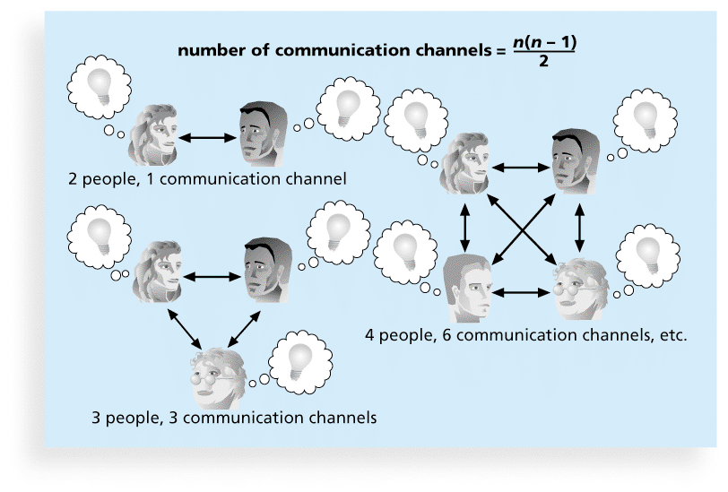
Figure 10-2. The Impact of the Number of People on Communications Channels

Slide 12
Planning Communications Management
Every project should include some type of communications management plan, a document that guides project communications
The communications management plan varies with the needs of the project, but some type of written plan should always be prepared
For small projects, the communications management plan can be part of the team contract
For large projects, it should be a separate document

Slide 13
Communications Management Plan Contents
1. Stakeholder communications requirements
2. Information to be communicated, including format, content, and level of detail
3. Who will receive the information and who will produce it
4. Suggested methods or technologies for conveying the information
5. Frequency of communication
6. Escalation procedures for resolving issues
7. Revision procedures for updating the communications management plan
8. A glossary of common terminology

Slide 14
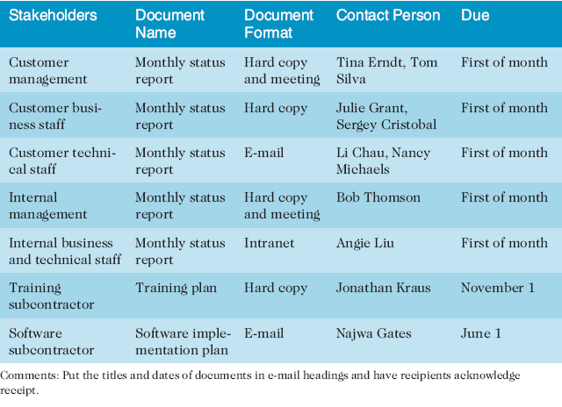
Table 10-1. Sample Stakeholder Analysis for Project Communications

Slide 15
Managing Communications
Managing communications is a large part of a project manager’s job
Getting project information to the right people at the right time and in a useful format is just as important as developing the information in the first place
Important considerations include the use of technology, the appropriate methods and media to use, and performance reporting

Slide 16
Reporting Performance
Performance reporting keeps stakeholders informed about how resources are being used to achieve project objectives
Status reports describe where the project stands at a specific point in time
Progress reports describe what the project team has accomplished during a certain period of time
Forecasts predict future project status and progress based on past information and trends

Slide 17
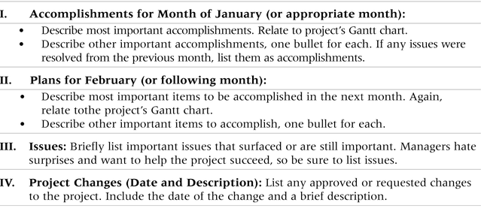
Table 10-3. Sample Template for a Monthly Progress Report

Slide 18
Controlling Communications
The main goal of controlling communications is to ensure the optimal flow of information throughout the entire project life cycle
The project manager and project team should use their various reporting systems, expert judgment, and meetings to assess how well communications are working. If problems exist, the project manager and team need to take action, which often requires changes to the earlier processes of planning and managing project communications
It is often beneficial to have a facilitator from outside the project team assess how well communications are working

Slide 19
Suggestions for Improving Project Communications
Develop better communication skills
Run effective meetings
Use e-mail and other technologies effectively
Use templates for project communications

Slide 20
Running Effective Meetings
Determine if a meeting can be avoided
Define the purpose and intended outcome of the meeting
Determine who should attend the meeting
Provide an agenda to participants before the meeting
Prepare handouts and visual aids, and make logistical arrangements ahead of time
Run the meeting professionally
Set the ground rules for the meeting
Build relationships

Slide 21
Sample Collaborative Tools
A SharePoint portal allows users to create custom Web sites to access documents and applications stored on shared devices
Google Docs allow users to create, share, and edit documents, spreadsheets, and presentations online
A wiki is a Web site designed to enable anyone who accesses it to contribute or modify Web page content

Slide 22
Chapter Summary
The goal of project communications management is to ensure timely and appropriate generation, collection, dissemination, storage, and disposition of project information
Main process include:
Plan communications management
Manage communications
Control communications

